Slide 1
Enrichment Exercise: Calculating Coefficient of Determination
Activity 6:
Mapping Seed Sources

Slide 2
Coefficient of Determination
The proportion of variation in one variable that is explained by another variable
Indicates the strength of the linear association between two variables
Denoted by R²
Usually shown as a percentage between 0% and 100% or as a decimal between 0 and 1.00

Slide 3
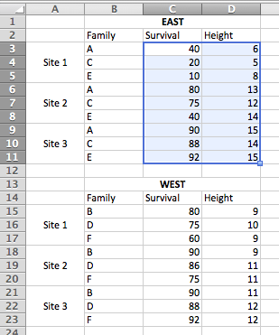
Using Excel to Compute R²
Step 1: Create data tables for the East and West genotypes.
Step 2a: Create two scatterplots, one for each data table (East and West). Do this by first selecting the Survival and Height data for East.

Slide 4
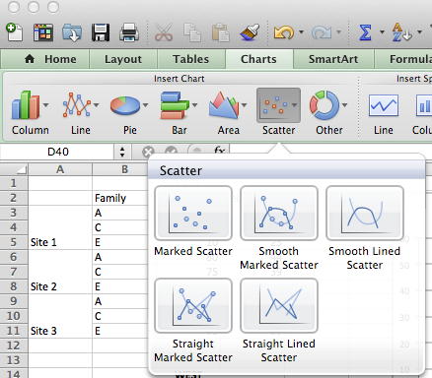
Using Excel to Compute R²
Step 2b: Once you have selected the data for East, click on the Charts tab, select the Scatterplot icon, and choose Marked Scatter. Repeat Step 2 for the West data, resulting in two scatterplots.

Slide 5
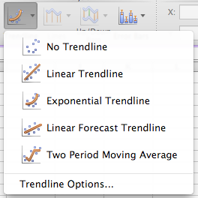
Using Excel to Compute R²
Step 3a: Add a trendline by selecting the East scatterplot. From the Chart Layout menu, click on the Trendline icon and select Linear Trendline
from the pop-up menu.

Slide 6
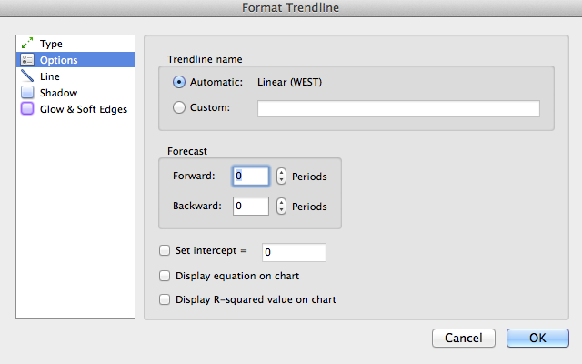
Using Excel to Compute R²
Step 3b. Once the trendline has appeared on the scatterplot, return to the Chart Layout menu. Again, click on the Trendline icon and select Trendline Options from the menu.
Step 3c: In the Format Trendline box, choose Options and check Display equation on chart and Display R-squared value on chart. Repeat for West data.
Notes:
SPOILER: The next slide contains the answers to Step 9 in Activity 5. Do not show until after students have completed their attempts to calculate the answers.

Slide 7
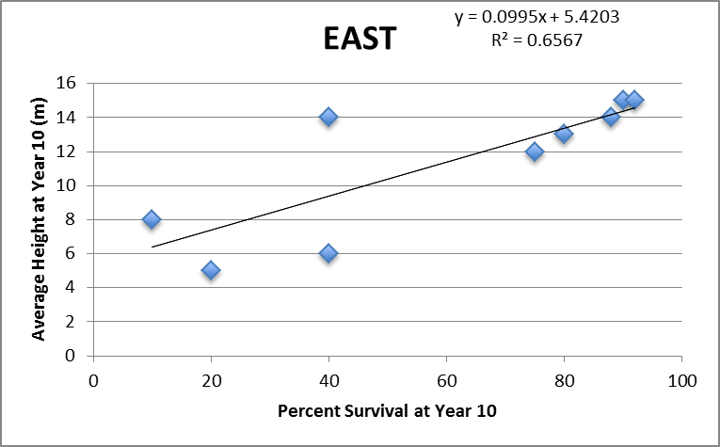
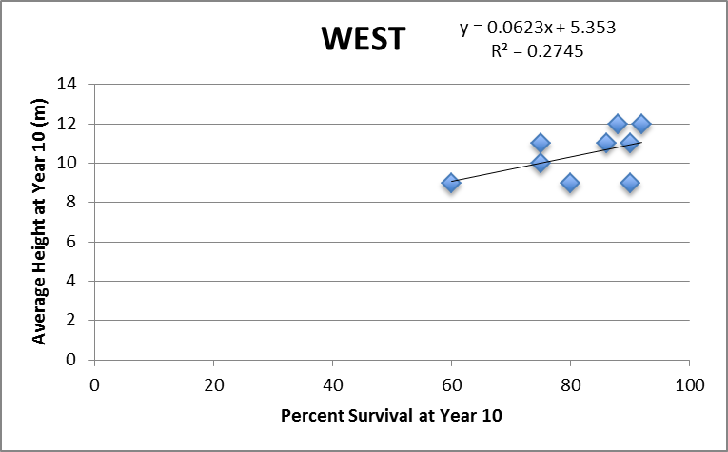
Answer Slide

