Slide 1


Creating Column Graphs in Excel®
Activity 6:
Mapping Seed Sources

Slide 2
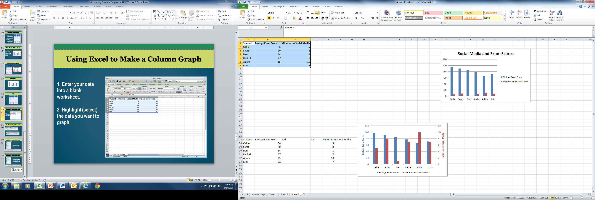
Using Excel to Make a Column Graph
1. Enter your data into a blank worksheet.
2. Highlight (select) the data you want to graph.

Slide 3
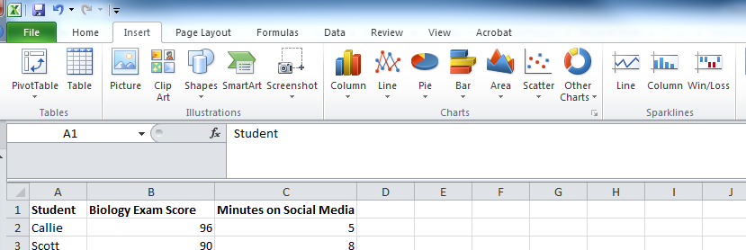
Using Excel to Make a Column Graph
Click on the Insert tab.
Click on the Column icon.

Slide 4
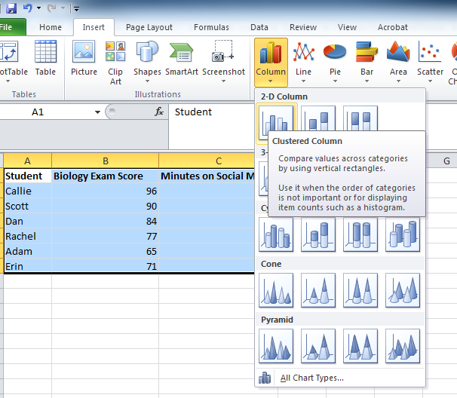
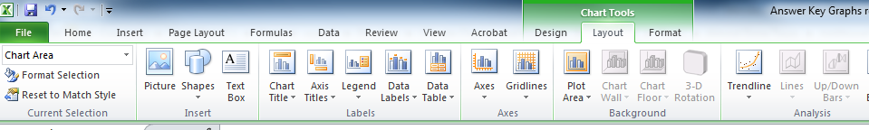
Using Excel to Make a Column Graph
Choose Clustered Column.
You can use the Layout tab to customize your graph (chart) by changing the title, the key (legend), axes, and other features.

Slide 5
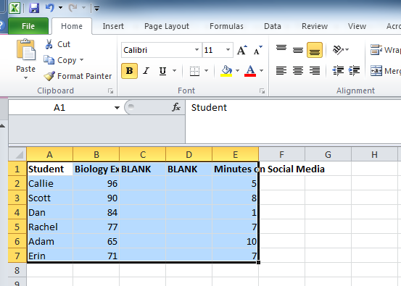
Creating Two y-axes
Insert two blank columns between your data.

Slide 6
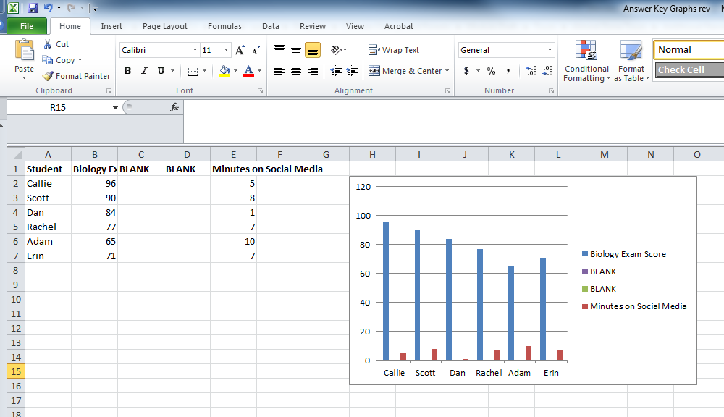
Creating Two y-axes
Delete “BLANK” from your legend.

Slide 7
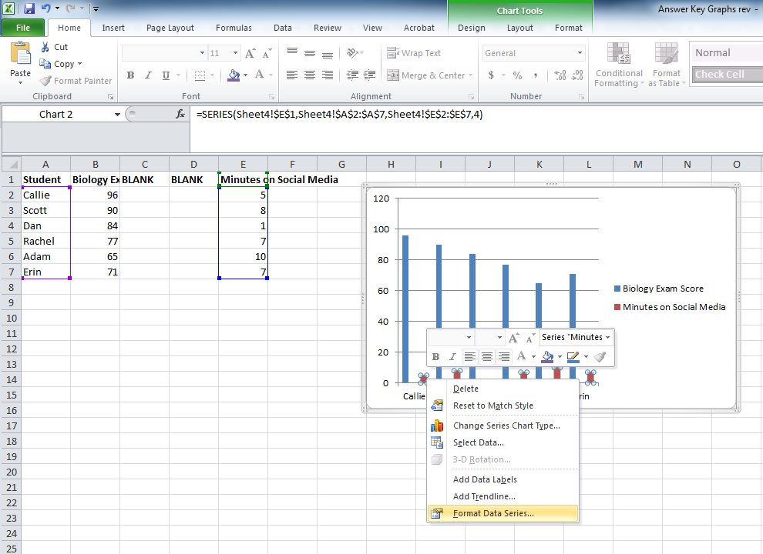
Creating Two y-axes
Click column that contains the data you want shown on the second y-axis.
Click Format Data Series.

Slide 8
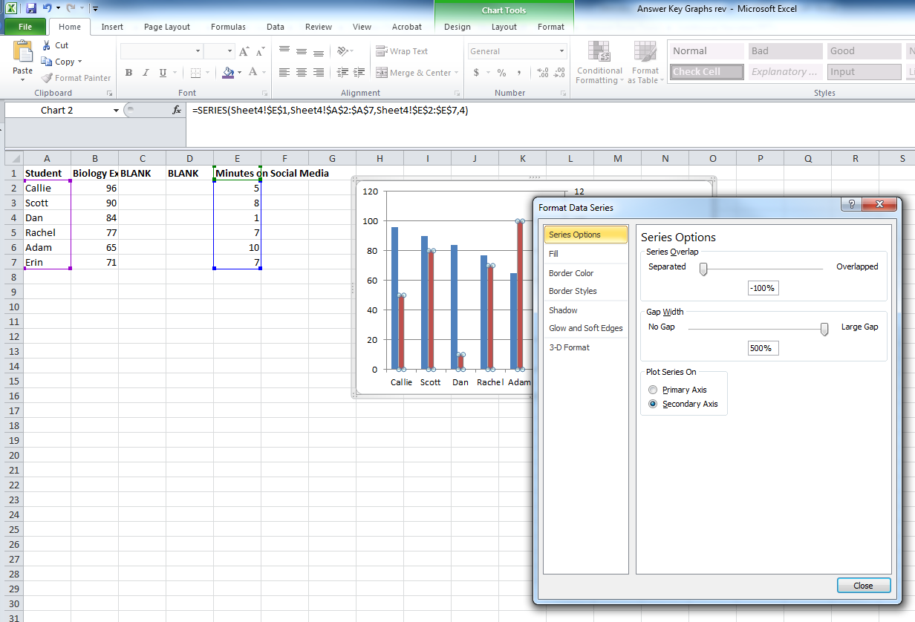
Creating Two y-axes
Click Secondary Axis.
Adjust Series Overlap and Gap Width.

Slide 9
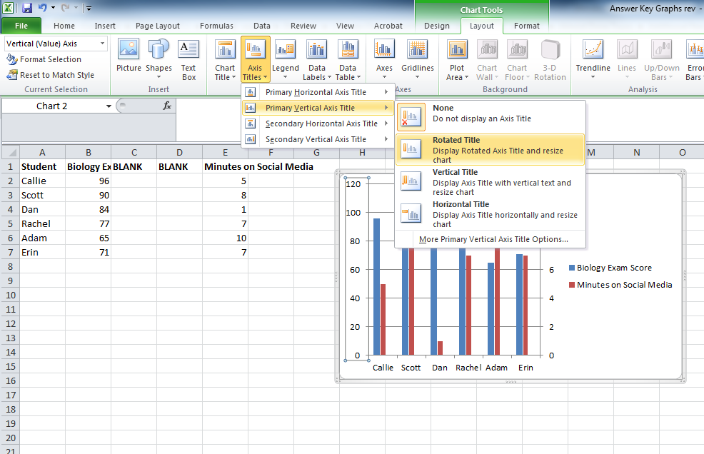
Creating Two y-axes
Add titles for the axes (include the measurement units).

Slide 10
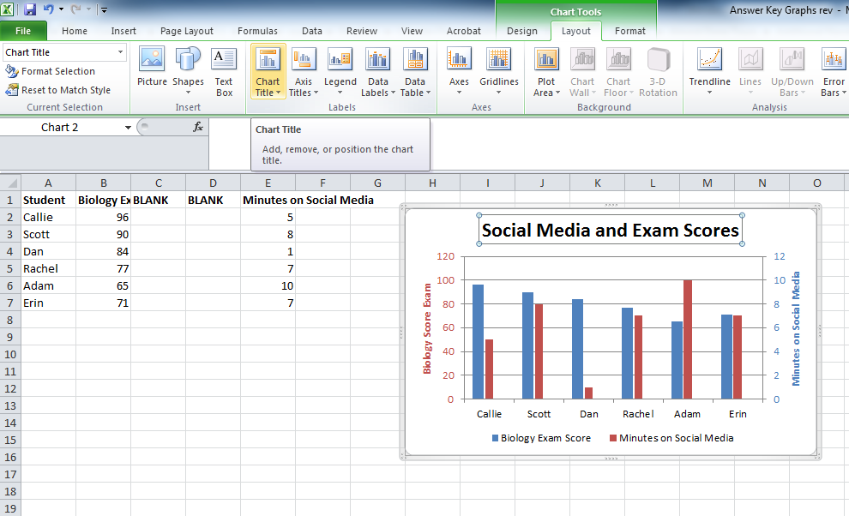
Creating Two y-axes
Use the Layout tab to customize your graph.

